Slide 1
File SYStem

Slide 2
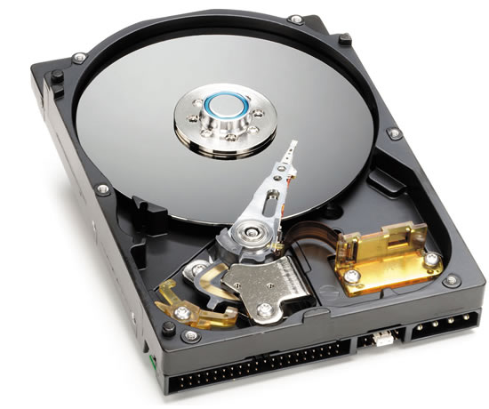
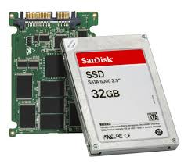
long term storage management
We often need to store
large amount of information
permanently
Usually we use Hard disk & newly solid-state drives for such long term storage

Slide 3
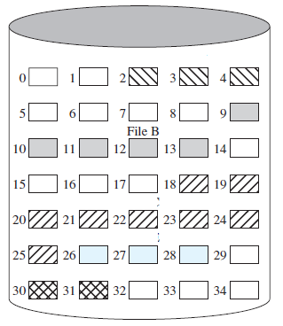
long term storage management
We can view this disks as a
linear sequence of fixed-size blocks
supports two operations:
Read K^{th} block.
Write K^{th} block
Now we have to answer
How to find desired information?
How to know which blocks are free?
…
Is it user friendly??

Slide 4
File system
file system consists of two distinct parts:
A collection of files
each storing related data
A Directory structure
organize and provide information about all the files in the system

Slide 5
Directories/Folders
Naming is nice, but limited
Humans like to group things together for convenience
File systems allow this to be done with directories (sometimes called folders)
Grouping makes it easier to
Find files in the first place: remember the enclosing directories for the file
Locate related files (or just determine which files are related)

Slide 6
Single-level directory systems
Root directory
A foo
A bar
B baz
C blah
One directory in the file system
Example directory
Contains 4 files (foo, bar, baz, blah)
owned by 3 different people: A, B, and C (owners shown in red)
Problem: what if user B wants to create a file called foo?

Slide 7
Two-level directory system
Root directory
A
B
C
A foo
A bar
B foo
B baz
C bar
C foo
C blah
Solves naming problem: each user has her own directory
Multiple users can use the same file name
By default, users access files in their own directories
Extension: allow users to access files in others’ directories

Slide 8
Hierarchical directory system
Root directory
A
B
C
A
Papers
A foo
A
Photos
B foo
B
Papers
C bar
C foo
C blah
A os.tex
A sunset
A
Family
B foo.tex
B foo.ps
A sunset
A kids
A Mom

Slide 9
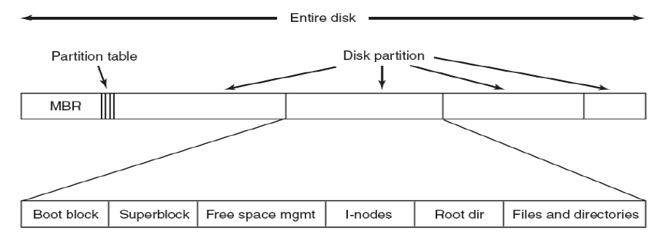
File System Layout

Slide 10
File System Layout
File systems are stored on hard disk
Hard disk can be divided up into one or more partitions, with independent file systems on each partition
Sector 0 of the disk is called the MBR(Master Boot Record) and is used to boot the computer
The end of the MBR contains the partition table

Slide 11
File System Layout
Entire disk
Partition table
Master boot record
Partition 1
Partition 2
Partition 3
Partition 4
Boot block
Super block
Free space management
Index nodes
Files & directories

Slide 12
File System Layout
Partition table gives the starting and ending addresses of each partition
One of the partitions in the table is marked as active
When the computer is booted, the BIOS reads in and executes the MBR
The first thing the MBR program does is locate the active partition, read in its first block, called the boot block , and execute it.
The program in the boot block loads the operating system contained in that partition.

Slide 13
File System Layout
For uniformity, every partition starts with a boot block,
even if it does not contain a bootable operating system.
Besides, it might contain one in the future
Other than starting with a boot block, the layout of a disk partition varies a lot from file system to file system
Often the file system contains a superblock
It contains all the key parameters about the file system
read into memory when the computer is booted or the file system is first touched.

Slide 14
File System Layout
Typical information in the superblock includes
a magic number to identify the file-system type
the number of blocks in the file system
other key administrative information.

Slide 15
I-nodes
The structure that describes
where the file is on the disk and
the attributes of the file
Associated with each file
I-nodes have to be stored on disks

Slide 16
Disk Block allocation
Keeping track of which disk blocks go with which file
The most important issue in implementing file system
Several options
Contiguous Allocation
Linked list allocation
Linked list allocation using a table in memory
I-nodes

Slide 17
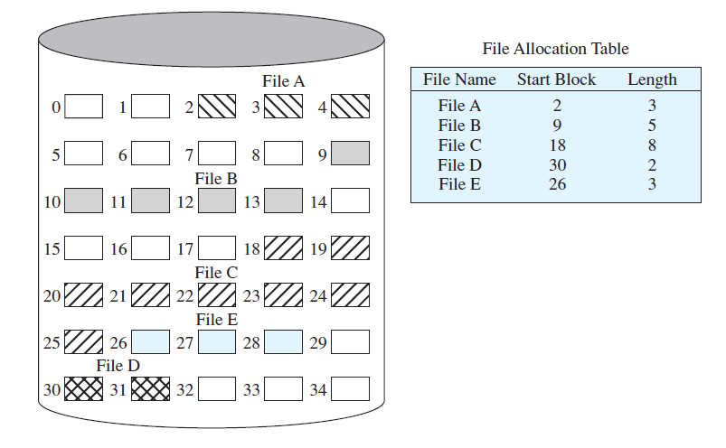
Contiguous Allocation

Slide 18
Contiguous Allocation
OS maintains an ordered list of free disk blocks
OS allocates a contiguous chunk of free blocks when it creates a file.
Need to store only the start location and size in the file descriptor

Slide 19
Contiguous Allocation advantage
Simple to implement because keeping track of where a file’s blocks are is reduced to remembering two numbers: the disk address of the first block and the number of blocks in the file.
the read performance is excellent because the entire file can be read from the disk in a single operation.
Only one seek is needed (to the first block).
After that, no more seeks or rotational delays are needed, so data come in at the full bandwidth of the disk.
Thus contiguous allocation is simple to implement and has high performance.
Usage: CD-ROM, DVD-ROM

Slide 20
Contiguous Allocation DISadvantage
Each file begins at the start of a new block, so that if file A was really 3½ blocks, some space is wasted at the end of the last block.
over the course of time, the disk becomes fragmented.
Leads to unusable data hole.

Slide 21
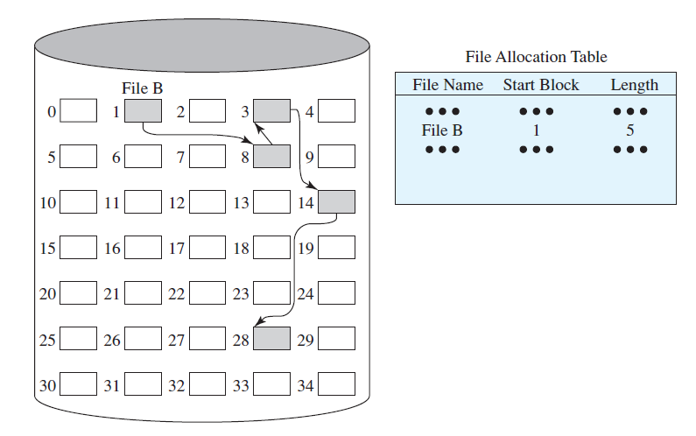
Linked list allocation

Slide 22
Linked list allocation
Keep a list of all the free blocks.
In the file descriptor, keep a pointer to the first block.
In each block, keep a pointer to the next block

Slide 23
Linked list allocation ADVANTAGE
every disk block can be used in this method.
No space is lost to disk fragmentation (except for internal fragmentation in the last block).
It is sufficient for the directory entry to merely store the disk address of the first block. The rest can be found starting there.

Slide 24
Linked list allocation disadvantage
although reading a file sequentially is straightforward, random access is extremely slow.
The amount of data storage in a block is no longer a power of two because the pointer takes up a few bytes.
While not fatal, having a peculiar size is less efficient because many programs read and write in blocks whose size is a power of two.
With the first few bytes of each block occupied by a pointer to the next block, reads of the full block size require acquiring and concatenating information from two disk blocks, which generates extra overhead due to the copying.

Slide 25
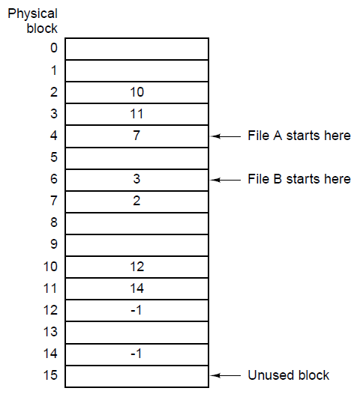
Linked List Allocation Using a Table in Memory
Taking the pointer out of each disk block, and putting it into a table in memory
Fast random access (chain is in RAM)

Slide 26
Linked List Allocation Using a Table in Memory advantage
Using this organization, the entire block is available for data.
Furthermore, random access is much easier.
Although the chain must still be followed to find a given offset within the file, the chain is entirely in memory,
so it can be followed without making any disk references.
Like the previous method, it is sufficient for the directory entry to keep a single integer (the starting block number) and still be able to locate all the blocks, no matter how large the file is

Slide 27
Linked List Allocation Using a Table in Memory disadvantage
The primary disadvantage of this method is that the entire table must be in memory all the time to make it work.
With a 1-TB disk and a 1-KB block size, the table needs 1 billion entries, one for each of the 1 billion disk blocks.
Each entry has to be a minimum of 3 bytes. For speed in lookup, they should be 4 bytes.
Thus the table will take up 3 GB or 2.4 GB of main memory all the time, depending on whether the system is optimized for space or time. Not wildly practical.
Clearly the FAT idea does not scale well to large disks. It was the original MS-DOS file system and is still fully supported by all versions of Windows though.

Slide 28
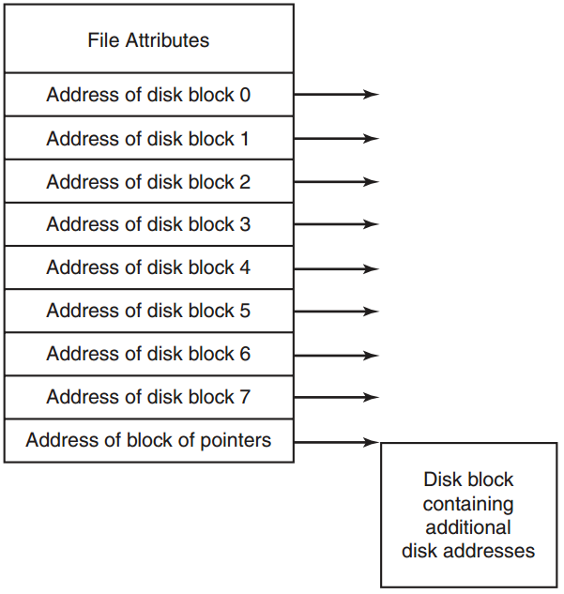
I-nodes
A data structure associated with each file
keeps track of which blocks belong to which file
used in UNIX file system
One problem with i-nodes is that if each one has room for a fixed number of disk addresses, what happens when a file grows beyond this limit?
One solution is to reserve the last disk address not for a data block, but instead for the address of a block containing more disk-block addresses

Slide 29

What’s in a directory?
Two types of information
File names
File metadata (size, timestamps, etc.)
Basic choices for directory information
Store all information in directory
Fixed size entries, one per file
Disk addresses and attributes in directory entry
Store names & pointers to index nodes (i-nodes)
i-node
games
attributes
games
mail
attributes
mail
i-node
news
attributes
news
i-node
research
attributes
research
Storing all information in the directory
Using pointers to index nodes
i-node

Slide 30
FIXED Lengthy file naming
The simplest approach is to set a limit on file-name length, typically 255 characters,
Advantages
Simple, easy to implement
Disadvantages
wastes a great deal of directory space, since few files have such long names.

Slide 31
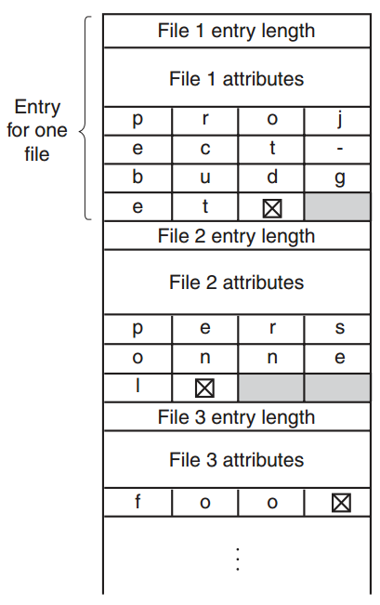
IN-LINE FILE NAMING
all directory entries are of the same size.
Each directory entry contains a fixed portion containing
The length of the entry
File attributes
Actual File Name
Each file name is terminated by a special character (usually 0)
To allow each directory entry to begin on a word boundary, each file name is filled out to an integral number of words

Slide 32
IN-LINE FILE NAMING
Disadvantages
When a file is removed, a variable-sized gap is introduced into the directory into which the next file to be entered may not fit.
A single directory entry may span multiple pages, so a page fault may occur while reading a file name

Slide 33
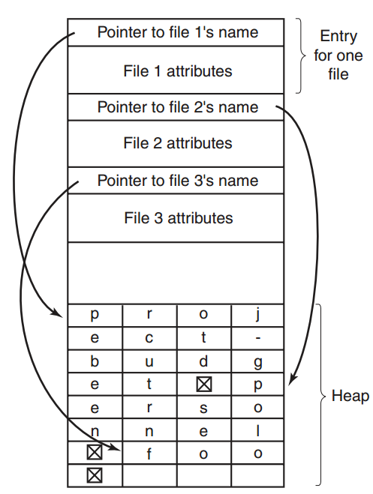
IN-HEAP FILE NAMING
Another way to handle variable-length names is to make the directory entries themselves all fixed length
keep the file names together in a heap at the end of the directory

Slide 34
IN-HEAP FILE NAMING
Advantages
Solves the fragmentation problem
Disadvantages
Heap management
Page fault still may occur

Slide 35
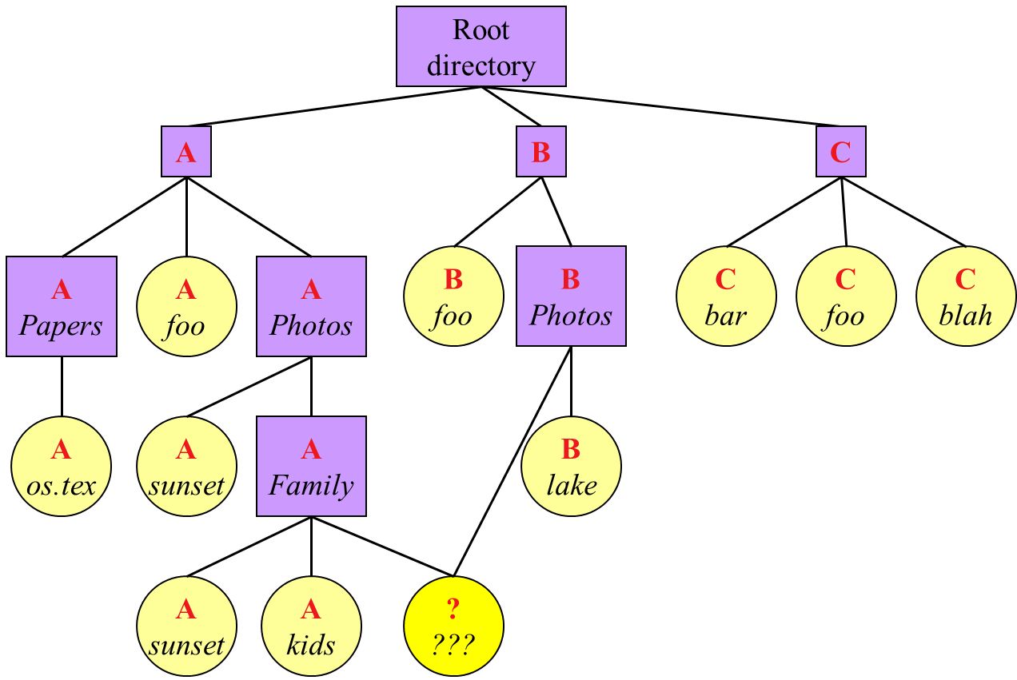
Shared files
When several users are working together on a project, they often need to share files.
As a result, it is often convenient for a shared file to appear simultaneously in different directories belonging to different users.

Slide 36
Shared file problems
If directories really do contain disk addresses, then a copy of the disk addresses will have to be made in B’s directory when the file is linked.
If either A or B subsequently appends to the file, the new blocks will be listed only in the directory of the user doing the append.
The changes will not be visible to the other user
Thus defeating the purpose of sharing.

Slide 37
Shared files PROBLEMS SOLUTION 1
Disk blocks are not listed in directories, but in a i-node.
The directories would then point just to the relevant i-nodes.

Slide 38
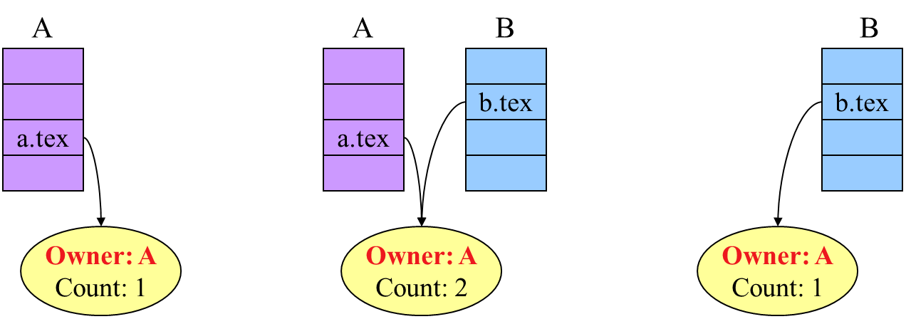
Shared files PROBLEMS SOLUTION 1
Drawbacks
B links to the shared file, the i-node records the file’s owner as A.
Creating a link does not change the ownership
But it does increase the link count in the i-node, so the system knows how many directory entries currently point to the file.

Slide 39
Shared files PROBLEMS SOLUTION 1
Drawbacks
If A later removes the file, the only thing to do is remove A’s directory entry, but leave the i-node intact, with count set to 1,
We now have a situation in which B is the only user having a directory entry for a file owned by A.
If the system does accounting or has quotas, A will continue to be billed for the file until B decides to remove it, if ever, at which time the count goes to 0 and the file is deleted.

Slide 40
Shared files PROBLEMS SOLUTION 2
B links to one of A’s files by having the system create a new file, of type LINK, and entering that file in B’s directory.
The new file contains just the path name of the file to which it is linked.
When B reads from the linked file, the operating system sees that the file being read from is of type LINK, looks up the name of the file, and reads that file.
This approach is called symbolic linking, to contrast it with traditional (hard) linking.

Slide 41
Shared files PROBLEMS SOLUTION 2
Advantages
With symbolic links previously described problem does not arise because only the true owner has a pointer to the i-node.
Users who have linked to the file just have path names, not i-node pointers.
When the owner removes the file, it is destroyed. Subsequent attempts to use the file via a symbolic link will fail when the system is unable to locate the file.
Removing a symbolic link does not affect the file at all.
They can be used to link to files on machines anywhere in the world, by simply providing the network address of the machine where the file resides in addition to its path on that machine.

Slide 42
Thank you

